Slide 1
Age Prediction Using Genomic Information
Project by Linh Phan
Dataset: Kaggle

Slide 2
Introduction
Genomic data has been growing at a remarkable speed
Multi-omic data can be used for vairous applications, both in research and in therapeutic applications.
Gene expression is related to regulation of bodily processes, which change significantly over the lifespan of a person
Gaining insights from how these gene expression correlate to age can shred a light on important processes that can be further investigated to slow down aging and/or prevent deterioration in health due to aging

Slide 3
Executive Summary
The goals include:
Analyze the correlation between gene expression levels and age to identify key biomarkers associated with certain ages
Build a model to predict a person age from their multi-omics data
Identify potential drug targets based on changes in gene expression related to ages
Significance of the project:
Identify the multi-omic age of any person
Recommend practices based on the genetic profile of a person to maximize anti-ageing
Identify drugs target for anti-aging therapies

Slide 4
Questions to answer:
What genes are the most/the least significantly related to ageing?
What genes are highly expressed in younger ages/older ages?
What methods can be used to derive a model to predict a person’s age based on their muli-omics data?
What are the performance metrics for the model?
How good is the selected model in predict a person’age based on their multi-omics data?
What genes are good candidates for a drug target?
How can the functions of those genes affect ageing?

Slide 5
Methodology
Data source: https://zenodo.org/record/2545213
Technicality:
Multi variate analysis
Hyperparameter optimization processes
License: https://creativecommons.org/publicdomain/zero/1.0/

Slide 6

Data Collection
Data was collected from Internet source at https://zenodo.org/record/2545213
Data include:
test_rows.csv
train_rows.csv

Slide 7
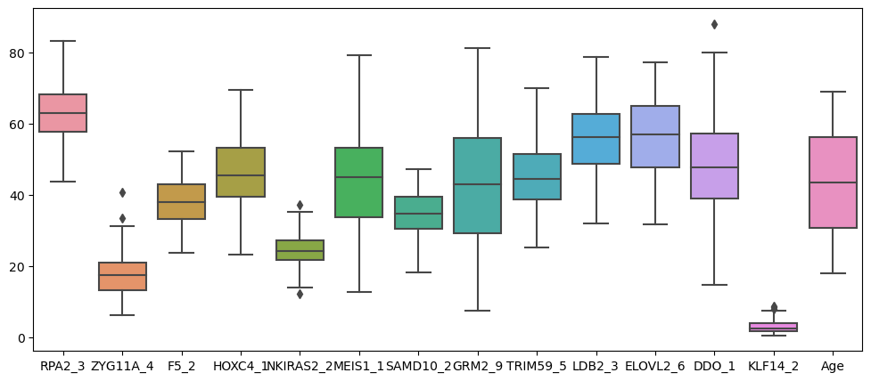
EDA
Perform EDA on train_rows.csv – Several potential outliers spotted

Slide 8
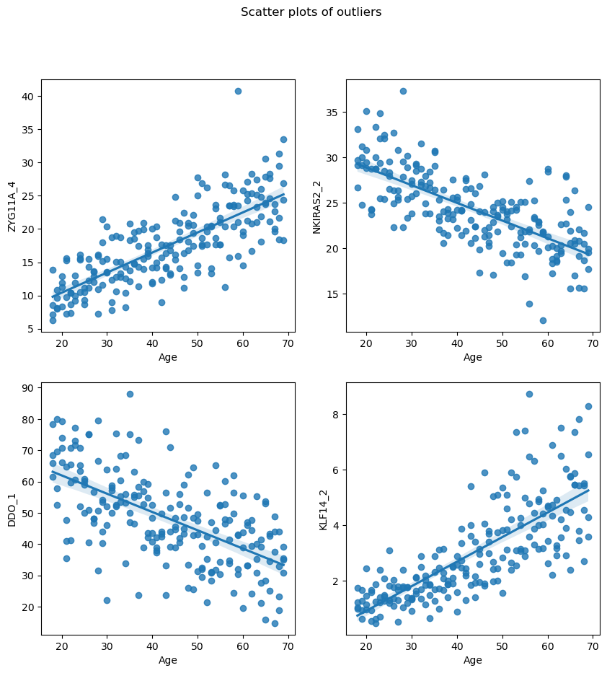
Scatterplots
Showing some outliers as well
Difficult to determine whether they might affect the model
IQR Analysis to remove outliers

Slide 9
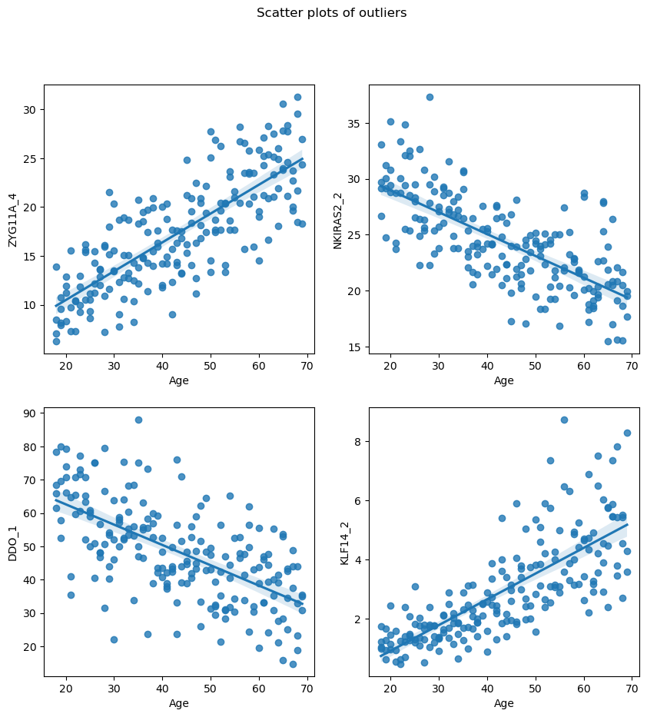
Data Wrangling
IQR = Q3 – Q1
Upper and lower limits determined by using the formular:
Upper limit = Q3 + 1.5*IQR
Lower limit = Q1 – 1.5*IQR
Scatterplots showing data after removal of outliers with IQR method.
Only a few data points were removed after IQR

Slide 10
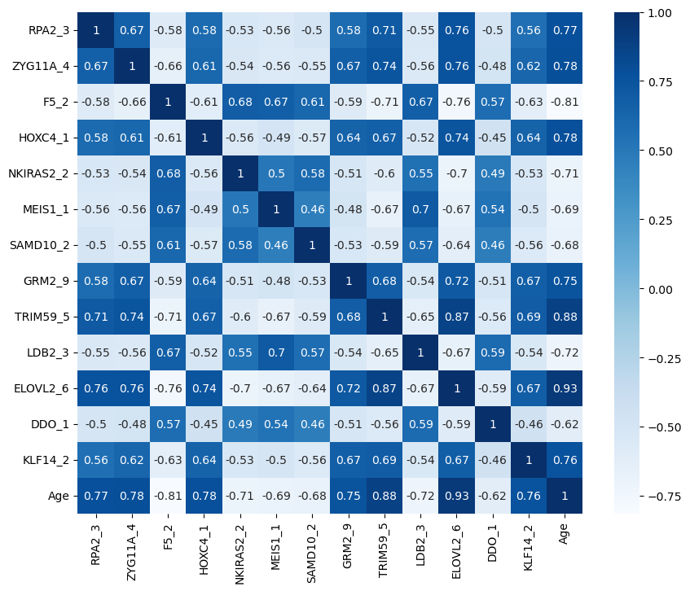
Correlation Matrix
What genes are the most/the least significantly related to ageing?
RPA2_3, ZYG11A_4, HOXC4_1, GRM2_9, TRIM59_5, ELOVL2_6 (the highest), KLF14 – Positively correlated with Age
F5_2 – Negatively correlated with Age

Slide 11
Questions to answers:
What genes are highly expressed in younger ages? (the most negative corrleation with ages)
F5_2, LDB2_3, NKIRAS2_2
What genes are highly expressed in older ages? (the most postitively correlation with ages)
ELOVL2_6, TRIM59_5, HOXC4_1, ZYG11A_4, RPA2_3
ELVOL2: encodes a transmembrane protein involved in the synthesis of very long polyunsaturated fatty acids (VLC-PUFAs). These fatty acids play important roles in retinal biology and photoreceptor renewal, key processes implicated in age-related eye diseases such as age-related macular degeneration (AMD) (Chao et al., 2020)
TRIM59: an E3 ubiquitin ligase in various cellular processes, including intracellular signaling, development, apoptosis, protein quality control, innate immunity, autophagy and carcinogenesis (Lou et al., 2019)

Slide 12
Machine Learning Model
Multi variate Linear Regression
Using sklearn
R2_score to assess the accuracy of the model
R2 Score on Train – Test Split: 0.95
R2 Score on Test data: 0.91
The model is quiet good at prediciting the ages.

Slide 13
References:
Chao, D. L., & Skowronska-Krawczyk, D. (2020). ELOVL2: Not just a biomarker of aging. Translational medicine of aging, 4, 78–80. https://doi.org/10.1016/j.tma.2020.06.004
Lou, M., Gao, Z., Zhu, T., Mao, X., Wang, Y., Yuan, K., & Tong, J. (2020). TRIM59 as a novel molecular biomarker to predict the prognosis of patients with NSCLC. Oncology Letters, 19, 1400-1408. https://doi.org/10.3892/ol.2019.11199

